Slide 1
Think about a word
typically related to
American Culture

Slide 2
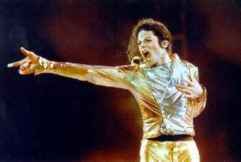
Individualism

Slide 3
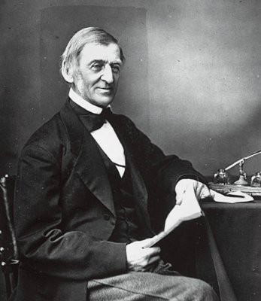
As an outstanding thinker, poet, essayist and lecturer, his thoughts have deeply influenced the culture of America
Confucius of America
the father of "American Civilization".
Ralph Waldo Emerson
1803-1882

Slide 4
American
Transcendentalism

Slide 5
Brief Introduction
It's the first American intellectual movement lasting from 1836 to 1855 in New England.

Slide 6
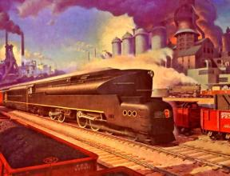
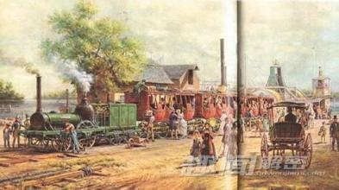
Background
America won the American Revolutionary War in 1783.Entering the 19th century, America was gradually becoming independent in politics completely. Along with the political independence, American people are eager for cultural independence to establish their own national spirits and value system. But meanwhile, rapid expanded economy made the society more materialistic and evil. People thought more about satisfying their desires rather than raising their spirit’s height.

Slide 7
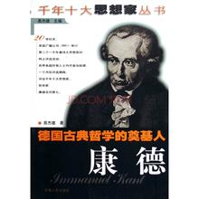
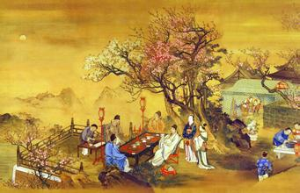
Transcendentalist Club
In order to save the soul of American people, some intellectuals formed an informal discussing group. Those who were impacted by idealistic philosophy of France and Germany met irregularly to discuss the new ideas of life and society. Their thoughts were also influenced by oriental mysticism like Hindu and Chinese classics. In conclusion, American transcendentalism blended American tradition and some foreign influences.

Slide 8
Main Concepts
(1) It took nature as the symbol of spirits of God. Nature was God's enlightenment toward human beings. So people should come close to nature for instructions. Nature showed humanity not only its own materiality but also taught human morality. Nature's beauty was the beauty of human mind.
(2) The concept of “Oversoul"
Emerson believed that Oversoul was an all-pervading unitary spiritual powers from which all things come and of which everyone was a part.

Slide 9
(3) It stressed the power of intuition. People could learn things both from the outside world by the means of five senses and learn from the inner world by intuition.

Slide 10
(4) It emphasized the significance of individual and believed that the ideal kind of individual was self-reliance and unselfish. People should depend on themselves for spiritual perfection.

Slide 11
The Positive Effects
of Individualism
To some extent, individualism does much with the generation and development of American democracy for it insisted on essential worth and dignity of individuals. It encourages everyone to stick to their own opinions and realize their personal value regardless of the tradition and custom.
Apart from it, we can also see the great influences of individualism in character building. American tend more to have a positive attitude towards their lives, enjoy their own way of living, and be delighted to face challenge. Instead of paying more attention to others, they are more likely to follow their own heart. And all these might explain why American are always creative.

Slide 12
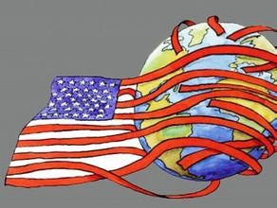
However, we should also see the rampant individualism in America had been far away from Emerson's expectation, and even distorts the real democracy.
Individualism has been used as a way to justify some people's strong desire for money. The indistinct border between individuality liberation and the loss of essential moral principles can make people confused.
What's more, rampant individualism makes American overlook other nations' culture and cannot be modest enough to regret for their evident mistakes.

Slide 13
Thanks for your listening

